Slide 1
BCSE202L & BCS202P- Data Structures and Algorithms
Dr. Priyanka N
Assistant Professor Senior Grade 1
School of Computer Science & Engineering
VIT, Vellore.

Slide 3
BCS202L- Data Structures and Algorithms
Text Books:
Mark A. Weiss, Data Structures & Algorithm Analysis in C++, 4 th Edition, 2013,Pearson Education.
Reference Books:
Alfred V. Aho, Jeffrey D. Ullman and John E. Hopcroft, Data Structures and Algorithms,1983, Pearson Education.
Horowitz, Sahni and S. Anderson-Freed, Fundamentals of Data Structures in C, 2008, 2nd Edition, Universities Press.
Thomas H. Cormen, C.E. Leiserson, R L. Rivest and C. Stein, Introduction to Algorithms, 2009, 3rd Edition, MIT Press.

Slide 4
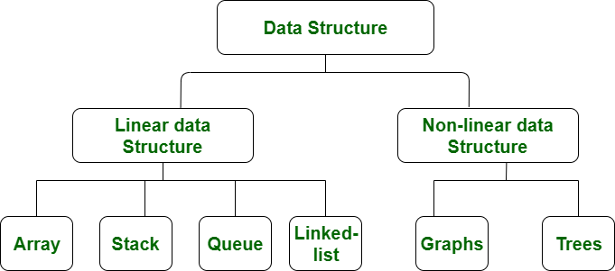

Slide 5
Linear Data Structure
Data are arranged in a linear sequence.
Elements are placed or accessed in
contiguous memory location.
Objects (items) in the data structure
can be traversed in a single run.
Some examples are array, stack, queue.

Slide 6
Stacks
What is Stack?
A stack is an ordered collection of homogeneous data element where the insertion and deletion take place at one end.
It is called a Last-in-First-Out (LIFO)collection.
It means, the item last entered will be first out.

Slide 7

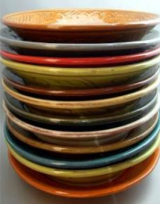
Examples
Stack of Books
Plates in a tray

Slide 8
Stacks Operations
What can we do with a stack?
push – operation to place an item on the stack
pop – operation to look at the item on top of the stack and remove it
Traversal- Displaying the items on the stack
is Full - To know whether the stack is full or not
is Empty - To know whether the stack is empty or not

Slide 9
Push and Pop
Push
Add an element to the top of the stack
Pop
Remove the element at the top of the stack
empty stack
push an element
push another
pop
top
B
top
top
top
A
A
A

Slide 10
Stack – push and pop example
M
D
D
D
C
push(M)
C
item = pop()
item = M
C
B
B
B
A
A
A

Slide 11
Implementing a Stack
Ways to implement a stack
Array
Linked list
Which method to use depends on the application
what advantages and disadvantages does each implementation have?

Slide 12
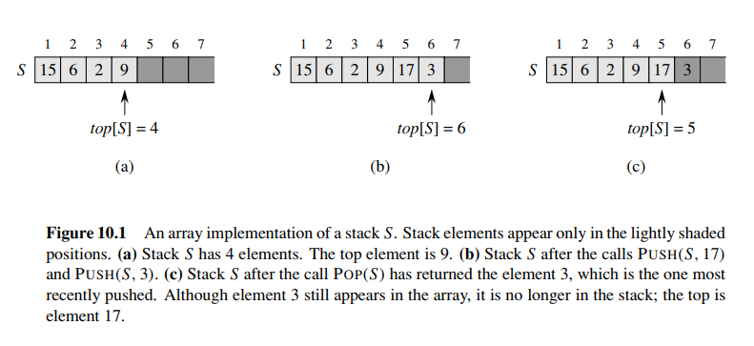
Array Implementation of Stack
Example :

Slide 13
Implementing Stacks: Array
Advantages
Best performance
Disadvantage
Fixed size
Basic implementation
Initially empty array
Field to record where the next data gets placed into
if array is full(stack Overflow), push() returns false
otherwise adds it into the correct spot
if array is empty(Stack Underflow), pop() returns null
otherwise removes the next(top) item in the stack

Slide 14
Stack Class (Array based)
Variable top;
Variable MAX;
variable stack[MAX];
top=-1;
max=4;
Stackfull()
empty()
push(int value)
pop()
display()

Slide 15
Push Operation
a
b
c
d
e
0
1
2
3
4
top
void push(element item)
{/* add an item to the global stack */
if (top >= MAX_STACK_SIZE - 1)
StackFull();
/* add at stack top */
stack[++top] = item;
}

Slide 16
Pop Operation
a
b
c
d
e
0
1
2
3
4
top
Void pop()
{ /* Deletes an item from the stack*/
if (top == -1)
return StackEmpty();
return stack[top--];
}

Slide 17
Peek Operation
a
b
c
d
e
0
1
2
3
4
top
Void peek()
{ /* returns the top item from the stack*/
if (top == -1)
return StackEmpty();
return stack[top];
}

Slide 18
Remaining Methods (array based)
bool Stackempty()
{
if (top==-1)
return true;
else
return false;
}
Bool Stackfull()
{
if (top== MAX_STACK_SIZE - 1)
return true;
else
return false;
}

Slide 19
Remaining Methods (array based)
void display()
{
if (top==-1)
return StackEmpty();
else
{
cout<<"The elements in stack are:";
for (int i=0;i<=top;i++)
cout<<"\n"<<a[i];
}
}

Slide 20
#include<stdio.h>
#include<conio.h>
#define SIZE 10 // size of the stack
void push(int);
void pop();
void display();
int stack[SIZE], top = -1;
void main()
{
int value, choice;
clrscr();
while(1)
{
printf("\n\n***** MENU *****\n");
printf("1. Push\n2. Pop\n3. Display\n4. Exit");
printf("\nEnter your choice: ");
scanf("%d",&choice);

Slide 21
switch(choice)
{
case 1: printf("Enter the value to be insert: ");
scanf("%d",&value);
push(value);
break;
case 2: pop();
break;
case 3: display();
break;
case 4: exit(0);
default: printf("\nWrong selection!!! Try again!!!");
}
}
}

Slide 22
void push(int value)
{
if(top == SIZE-1)
printf("\nStack is Full!!! Insertion is not possible!!!");
else
{
top++;
stack[top] = value;
printf("\nInsertion success!!!");
}
}

Slide 23
void pop()
{
if(top == -1)
printf("\nStack is Empty!!! Deletion is not possible!!!");
else
{
printf("\nDeleted : %d", stack[top]);
top--;
}
}
void display()
{
if(top == -1)
printf("\nStack is Empty!!!");
else
{
int i;
printf("\nStack elements are:\n");
for(i=top; i>=0; i--)
printf("%d\n",stack[i]);
}
}

Slide 24
Stack Applications
It is a very common data structure
Stacks are used in conversion of infix to postfix expression.
Stacks are also used in evaluation of postfix expression.
Stacks are used to implement recursive procedures (eg: Towers of Hanoi).
Stacks are used in compiler design.
Memory Management in Operating System.

